Slide 1
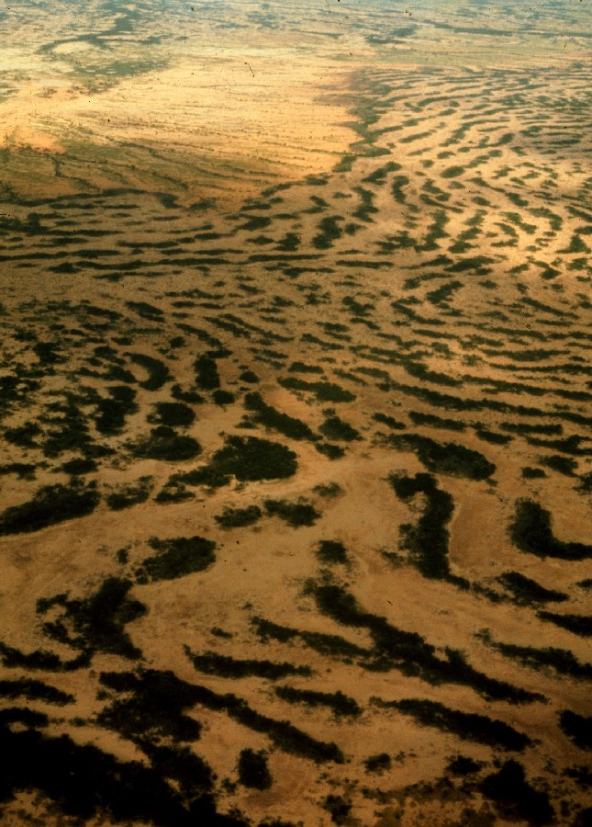
Pattern formation - a missing link in the study of ecosystem response to environmental changes
Ehud Meron
Department of Solar Energy & Environmental Physics
and
Physics Department
Ben-Gurion University
Winter School on
Patterns of vegetation in water controlled ecosystems
January 3-9, 2016, Venice
Notes:
The significance of nonlinearity in ecological research is well recognized and concepts such as multistability, oscillations and chaos are well integrated. Ecosystems, however, are spatially extended and the coupling of nonlinearity and space is largely ignored, although there is a well developed theory that addresses this coupling – pattern formation theory.
In this talk I will argue that the conceptual and theoretical framework of pattern formation theory is necessary for understanding ecosystem dynamics and ecosystem response to environmental variability, such as desertification as we see in the background picture

Slide 2
Outine
Lecture I: A glimpse into pattern formation theory
Lecture II: Pattern formation as a missing link in the study of ecosystem response to environmental changes
Vegetation pattern formation as a landscape-level response to water stress: the positive feedbacks that drive pattern-forming instabilities of uniform vegetation.
Mathematical modeling: a means for scaling up small-scale spatial processes to landscape-level patterns, and organism-level traits to community-level properties.
Pattern-formation – a missing link: model studies that demonstrate possible pattern-formation links between the abiotic environment, biodiversity and ecosystem function.
Human intervention and ecological integrity: following the inherent modes of self-organization.
Ben Gurion University, Ehud Meron - www.bgu.ac.il/~ehud

Slide 3
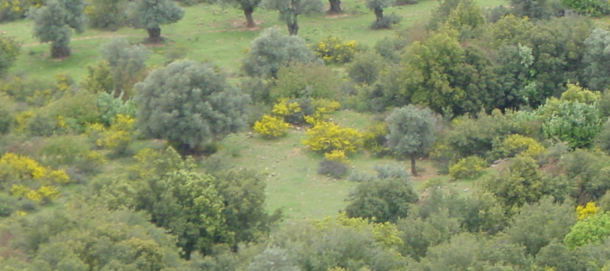
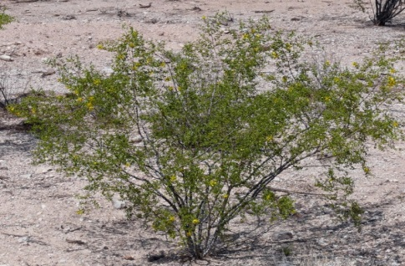
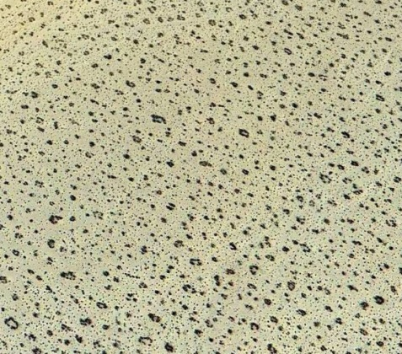
Pattern formation - a landscape-level ecosystem response
Community level
Biodiversity change
Organism level
Phenotype change
Abiotic environment
Ecosystem response
Ecosystem function
Ben Gurion University, Ehud Meron - www.bgu.ac.il/~ehud
Landscape level
Pattern formation
We discussed two general mechanisms of pattern formation: non-uniform instability and uniform instability leading to multi-stability. Which of these mechanisms applies to vegetation pattern formation and what are the positive feedbacks involved?
Notes:
Reductionist approach – study the organism level, phenotypic changes, environmental filteringing. The remaining species determine ecosystem function.
But the system can respond in higher organization levels too. Community-level response affects biodiversity which in turn affects ecosystem function.
Population-level responses may result in spatial self organization or pattern formation which also affects ecosystem function.
…
We do that by mathematical modeling, and the next big question is what to model?

Slide 4
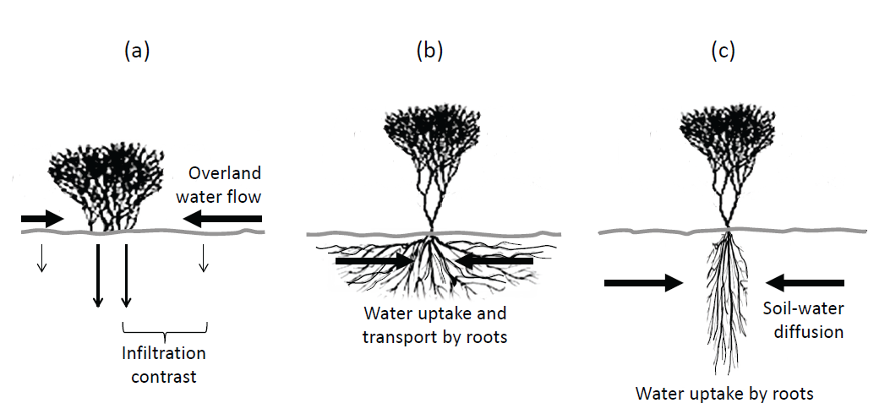
Pattern formation - a landscape-level ecosystem response
Positive biomass-water feedbacks:
+
Local vegetation growth
Water transport towards growing vegetation
Three water transport
mechanisms:
+
Ben Gurion University, Ehud Meron - www.bgu.ac.il/~ehud
Water uptake and
conduction by laterally
extended roots
Water transport helps local vegetation growth but inhibits growth in the patch surroundings  pattern-forming feedbacks
Note: each feedback alone can produce patterns. The infiltration feedback involves short range facilitation and long range competition, but the other feedbacks involve only competition
Also termed scale-dependent feedbacks
(Rietkerk and van de Koppel, TREE 2008)
Notes:
All three transport mechanisms are enhanced by vegetation growth …
To test whether these feedbacks can lead to pattern forming instabilities we should translate them to mathematical terms in model equations and then analyse these equations.
Let me present to you a model that captures all the three of them.

Slide 5
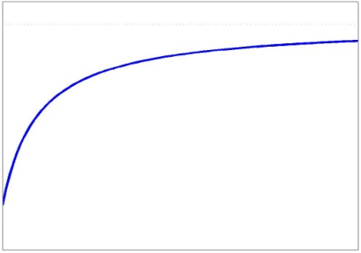
Mathematical modeling – upscaling feedbacks to patterns
A model that captures all three feedbacks (in dimensionless form):
(Gilad, Hardenberg, Provenzale, Shachak, Meron, Phys. Rev. Lett. 2004, J. Theor. Biol. 2007)
$$H$$
$$∂_{t}B=G_{B}B\left(1−B/K\right)−MB+{D_{B}∇}^{2}B$$
Above-ground biomass ($kg/m^{2}$)
$$Z$$
$$∂_{t}W={IH−LW−G_{W}W}_{ }+D_{W}∇^{2}W$$
Soil-water content ($kg/m^{2}$)
$$∂_{t}H={P−IH−∇⋅J J=−2δ_{H}H}_{ }∇(H+Z)$$
Surface-water ($kg/m^{2}$ or mm)
$G_{B}=Λ∫G\left(x,x^{′},t\right)W\left(x^{′},t\right)dx′$
Three water transport mechanisms:
Overland flow
Conduction by roots
Soil-water diffusion
Soil-water diffusion feedback: $D_{W}$ large compared to $D_{B}$, and strong $B$ dependence of $G_{W}$
Ben Gurion University, Ehud Meron - www.bgu.ac.il/~ehud
$$G_{W}=Γ∫G\left(x′,x,t\right)B\left(x^{′},t\right)dx′$$
$$G\left(x,x^{′},t\right)=\frac{1}{πs_{0}^{2}}exp\left(−\frac{{\left|x−x^{′}\right|}^{2}}{s{\left[B(x,t)\right]}^{2}}\right){ }$$
Root augmentation as plant grows
$E=s_{0}^{−1}ds/dB_{|B=0}$ - root to shoot ratio
$$s\left(B\right)≈s_{0}(1+EB)$$
$C= 1$no contrast
$$A$$
$$I(x,t)=A\frac{B(x,t)+Q/C}{B(x,t)+Q}$$
Infiltration contrast between vegetation patch and bare soil
I
$C>>1$
high contrast
$$A/C$$
Walker 1980
0
B
Notes:
So where are the biomass-water feedbacks in this model?
Let me begin with the root-augmentation feedback:

Slide 6
Mathematical modeling – upscaling feedbacks to patterns
The model can be simplified by switching off irrelevant feedbacks:
Confined root zones:
$G_{B}=Λ∫G\left(x,x^{′},t\right)W\left(x^{′},t\right)dx^{′}≈ΛW{\left(1+EB\right)}^{2}$
The model still captures the infiltration and soil-water diffusion feedbacks
$$G_{W}=Γ∫G\left(x^{′},x,t\right)B\left(x^{′},t\right)dx^{′}≈ΓB{\left(1+EB\right)}^{2}$$
Ben Gurion University, Ehud Meron - www.bgu.ac.il/~ehud
No infiltration contrast (e.g. sandy soil):
$I$ is independent of $B$, and the $H$ equation decouples  2-variable model:
$$∂_{t}B=G_{B}B\left(1−B/K\right)−MB+{D_{B}∇}^{2}B$$
The model still captures the soil-water diffusion feedback
$$∂_{t}W={P−LW−G_{W}W}_{ }+D_{W}∇^{2}W$$
Notes:
So where are the biomass-water feedbacks in this model?
Let me begin with the root-augmentation feedback:

Slide 7
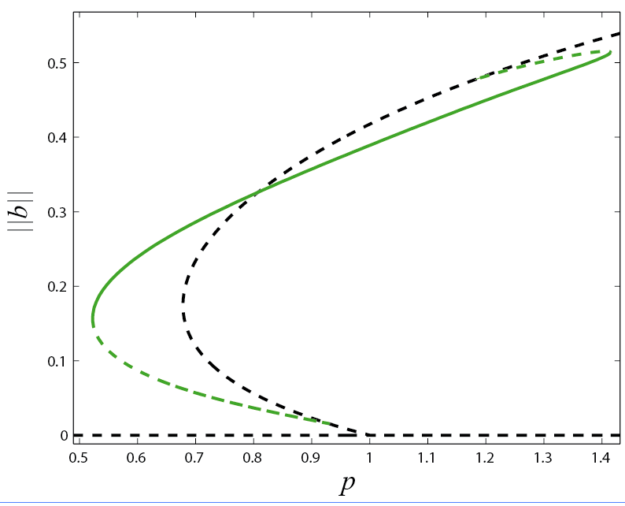
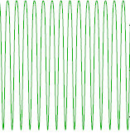
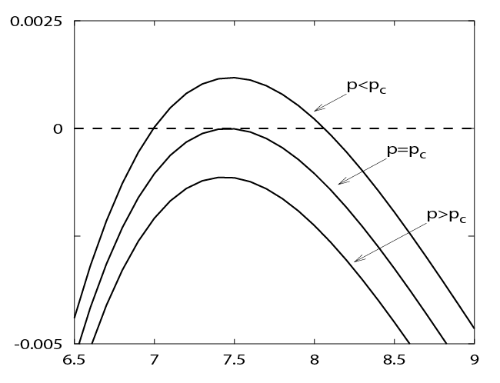
Mathematical modeling – upscaling feedbacks to patterns
Bifurcation diagram (plane terrain)
Uniform states:
Bare-soil (b = 0)
Uniform vegetation (b ≠ 0)
Spatially periodic states:
uniform vegetation loses stability to growth of non-uniform perturbations
Uniform vegetation
Periodic pattern
Note, the periodic patterns extend to lower precipitation values compared to uniform vegetation – vegetation pattern formation as a landscape-level means to cope with water stress.
Ben Gurion University, Ehud Meron - www.bgu.ac.il/~ehud
Bare soil
$$p_{c}$$
In 2d  hexagonal gap patterns
Growth rate
0
Five basic morphologies along the rainfall
gradient:
Universal sequence of states (Gowda, Riecke, Silber PRE 2014)
$$k_{c}$$
Wavenumber k

Slide 8
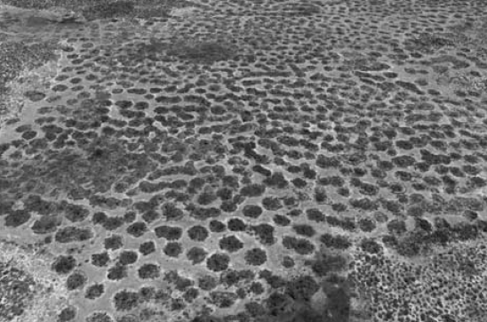
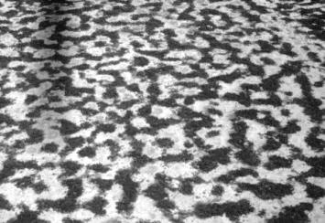
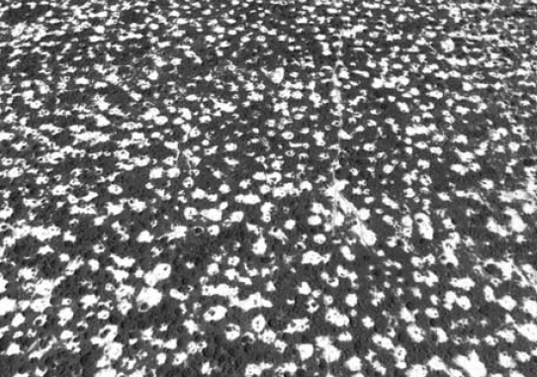
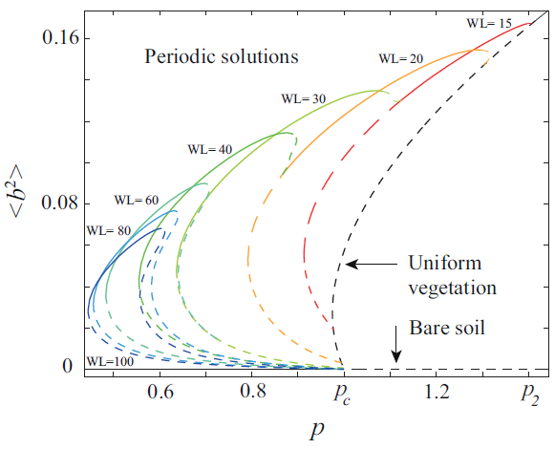
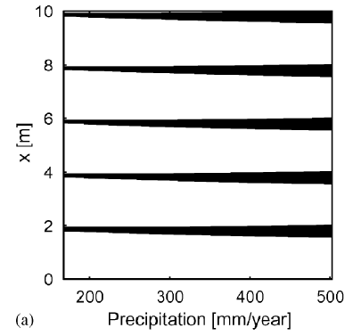
Mathematical modeling – upscaling feedbacks to patterns
Observed in nature:
Spots (Zambia)
Labyrinth (Niger)
Gaps (Senegal)
(Borgogno et al. Reviews of Geophysics 2009)
Not the whole story!
A family of periodic patterns
When a solution branch with a fixed wavelength becomes unstable a transition to a higher wavelength solution takes place:
(Zelnik et al., Phil. Trans. R. Soc. A 2013)
(Siteur et al., Ecological Complexity 2014)
Ben Gurion University, Ehud Meron - www.bgu.ac.il/~ehud
space
(Yizhaq, Gilad, Meron, Physica A 2005)
$$p$$
Altogether, three response forms to decreasing precipitation $p$:
Vegetated domains shrink in size keeping wavelength and morphology unchanged
Transitions to higher wavelength keeping morphology unchanged
Morphology changes: gaps $→$ stripes $→$ spots

Slide 9
Mathematical modeling – upscaling feedbacks to patterns
Constant slope (Gilad et al., J. Theor. Biol. 2007):
Similar behaviors except:
Stripes or bands are ⊥ slope
Migrate up hill
Bands appear in wider $p$ range
downhill
Mechanism of migration:
Precipitation
Ben Gurion University, Ehud Meron - www.bgu.ac.il/~ehud
infiltration
Note: a similar mechanism applies to other circumstances of water advection, such as fog carried out by wind that is intercepted by the vegetation (Borthagaray, Fuentes, Marquet, J. Theo. Biol. 2010) .
Banded vegetation in Somalia

Slide 10
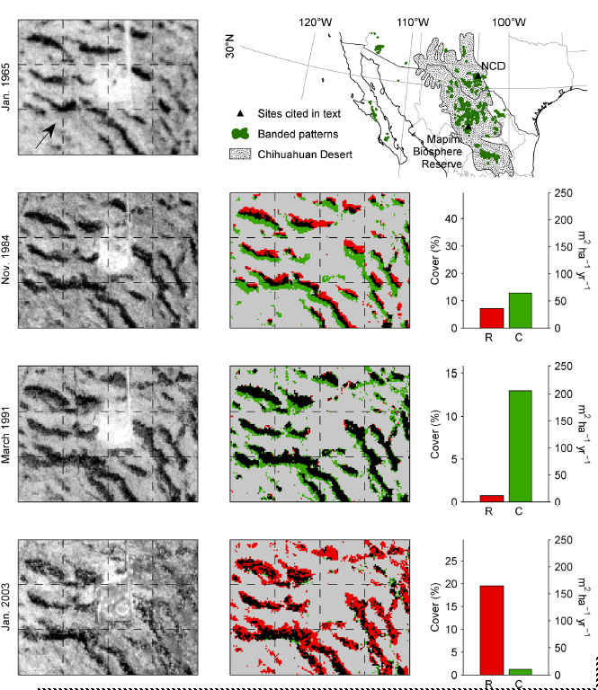
Mathematical modeling – upscaling feedbacks to patterns
Migration has been
observed:
Chihuahuan desert
Deblauwe, Couteron, Bogaert, Barbier, Ecological Monographs 2012
Downhill
Vegetation colonization
Vegetation retreat
Persistent vegetation
Persistent bare soil
Ben Gurion University, Ehud Meron - www.bgu.ac.il/~ehud
High rainfall period
Low rainfall period

Slide 11
Mathematical modeling – upscaling feedbacks to patterns
Relation to other models
Klausmeier model (Klausmeier, Science 1999; Ursino, Adv. Water Res. 2005; Sherratt, J.
Math. Biol. 2005; Sherrat & Synodinos, DCDS 2012; Sherratt, PNAS 2015; van der Stelt et al., J.
Nonlinear Sci. 2013; Siero et al., Chaos 2015):
$$∂_{t}B=G_{B}B−MB+{D_{B}∇}^{2}B$$
$$G_{B}=ΛWB (K→∞)$$
$$∂_{t}W={P−LW−G_{W}W}_{ }+V∂_{x}W$$
$$G_{W}=ΓB^{2}$$
$$(D_{W}=0)$$
Applies to sloped terrains only:
Here $W$ stands for surface water that flows downhill at speed $V$
Pattern formation due to advection.
On a flat terrain $\left(V=0\right)$stationary patterns cannot form.
Ben Gurion University, Ehud Meron - www.bgu.ac.il/~ehud
Gray-Scott model:
$$∂_{t}B=G_{B}B−MB+{D_{B}∇}^{2}B$$
$$G_{B}=ΛWB (K→∞)$$
$$∂_{t}W={P−LW−G_{W}W}_{ }+{ D}_{W}∇^{2}W$$
$$G_{W}=ΓB^{2}$$
Here $W$stands for soil water.
Pattern formation due to soil-water diffusion feedback.
A combination of the 2 models, the KGS model, has also been studied (what $W$ stands for?)
(van der Stelt, Doelman, Hek, Rademacher, J. Nonlinear Sci. 2012)

Slide 12
Mathematical modeling – upscaling feedbacks to patterns
Relation to other models
Rietkerk et al. model (Rietkerk et al., American Naturalist 2002):
$$∂_{t}B=G_{B}B−MB+{D_{B}∇}^{2}B$$
$$G_{B}=ΛW/(W+W_{0}) (K→∞)$$
$$∂_{t}W={IH−LW−G_{W}W}_{ }+D_{W}∇^{2}W$$
$$G_{W}=ΓB/(W+W_{0})$$
$$∂_{t}H={P−IH+D_{H}∇^{2}H }_{ }$$
${(D}_{H}∇^{2}H$ instead of $D_{H}∇^{2}H^{2})$
Captures the infiltration feedback, does not capture the root-augmentation feedback and the soil-water diffusion feedback. Simplifies the surface-water transport term – linear diffusion.
Ben Gurion University, Ehud Meron - www.bgu.ac.il/~ehud
Additional models:
Lefever and Lejune (Bull. Math. Biol. 1997); von Hardenberg, Meron, Shachak, Zarmi (Phys.
Rev. Lett. 2001); model variations: Ursino (Adv. Water Res. 2005), Saco, Willgoose, Hancock
(Hydrol. Earth Sys. Sci. 2007); Thompson, Katul, McMahon (Water Resources Res. 2008) and
others.
Back to the Gilad et al. model: by capturing more than a single pattern-forming feedback this model allows the study of additional questions, related to the interplay between different feedbacks (e.g. transition from competition to facilitation) and applying the model to a wider variety of specific ecosystems.

Slide 13
Mathematical modeling – upscaling traits to com. structure
Extending the model to a community of species is straightforward:
$$∂_{t}B_{i}=G_{B}^{i}B_{i}\left(1−B_{i}/K_{i}\right)−M_{i}B_{i}+{D_{B}}_{i}∇^{2}B_{i} i=1,…,n$$
# of populations
$$∂_{t}W={IH−LW−W∑G_{W}^{i}}_{ }+D_{W}∇^{2}W$$
$$∂_{t}h={P−IH−∇⋅J J=−2D_{H}H}_{ }∇(H+Z)$$
$G_{B}=Λ_{i}∫G_{i}\left(x,x^{′},t\right)W\left(x^{′},t\right)dx′$
$$G_{W}=Γ_{i}∫G_{i}\left(x^{′},x,t\right)B_{i}\left(x^{′},t\right)dx′$$
$$G_{i}\left(x,x^{′},t\right)=\frac{1}{πs_{0i}^{2}}exp\left(−\frac{{\left|x−x^{′}\right|}^{2}}{s_{i}{\left[B_{i}(x,t)\right]}^{2}}\right){ }$$
Ben Gurion University, Ehud Meron - www.bgu.ac.il/~ehud
$$s_{i}\left(b_{i}\right)≈s_{0i}(1+E_{i}B_{i})$$
But how should we distinguish between species? Many traits, species may differ in traits that are not essential for ecosystem function.
Rather than considering all species traits, consider only functional traits, which can be divided into (Suding et al. Glob. Change Biol. 2008):
Response traits that affect environmental filtering
Effect traits that affect ecosystem function.
Rather then considering species, we consider functional groups of species that share the same values of a few functional traits.

Slide 14
Mathematical modeling – upscaling traits to com. sturcture
Extend the space over which the biomass variable is defined to
include a subspace of functional traits $χ=(χ_{A},χ_{B}, …)$:
$$B=B(x,t;χ)$$
Above-ground biomass per unit area in physical subspace and per unit volume in trait subspace.
physical subspace
trait subspace
$$χ_{B}$$
Define the ith functional group as a volume
element $ΔV$ around the point $χ_{i}=\left(χ_{Ai},χ_{Bi}, …\right)$in
trait space - represents a group of species that
share the trait values within $ΔV$.
$χ_{i}$ ith functional group
$$χ_{Bi}$$
Ben Gurion University, Ehud Meron - www.bgu.ac.il/~ehud
$$χ_{Ai}$$
$$χ_{A}$$
$B_{i}=B\left(x,t;χ_{i}\right)ΔV$ - total biomass per unit area of ith functional group.
Choice of functional traits:
$E_{i} −$root-to-shoot ratio $\left(η_{i}=E_{i}K_{i}\right):$ controls the ability to capture soil water (response trait)
$K_{i} −$maximum standing biomass: provides a measure for bio-productivity (effect trait)
Notes:
How do we do that? We extend the space over which the biomass variables are defined to include a trait subspace, in addition to the physical space,
And distinguish among species within a functional group by their …

Slide 15
Mathematical modeling – upscaling traits to com. sturcture
Consider for simplicity a spatially uniform herbaceous community for which we can eliminate the equation for surface water and calculate the root integrals:
Competition for light
$$\dot{B_{i}}=Λ_{i}B_{i}\left(1−\frac{B_{i}}{K_{i}}\right){\left(1+E_{i}B_{i}\right)}^{2}−M_{i}B_{i}$$
$$Λ_{i}=Λ_{0i}\left(1−\frac{\sum_{j≠i}{B_{j}}}{\sum_{j}{B_{j}+h}}\right)$$
$$\dot{W}=P−LW−ΓW∑B_{i}{\left(1+E_{i}B_{i}\right)}^{2}$$
$$M_{i}=M_{0i}+M_{1i}B_{i}$$
Grazing stress
Ben Gurion University, Ehud Meron - www.bgu.ac.il/~ehud
Assume further that there is a tradeoff between the two functional traits, represented by a tradeoff parameter $0<χ<1$:
(shoot)
α>1
α=1
α<1
α - characterizes the pool of functional groups
(root/shoot)
Notes:
How do we do that? We extend the space over which the biomass variables are defined to include a trait subspace, in addition to the physical space,
And distinguish among species within a functional group by their …

Slide 16
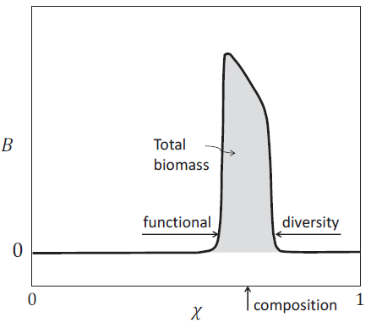
Mathematical modeling – upscaling traits to com. sturcture
Model equations typically have stationary pulse solutions
Provide information about 3 community-level properties:
Functional diversity (width)
Composition (position)
Total biomass (area)
Ben Gurion University, Ehud Meron - www.bgu.ac.il/~ehud
Derive additional community-level properties by studying pulse solutions as we vary various parameters, e.g. diversity-precipitation relations.
Altogether, a model platform that can be used to scale up small patch-scale processes to large landscape-scale patterns, and organism-level traits to community-level properties.
Notes:
So what are the mechanisms that produce such patterns? These mechanisms are associated with two important feedbacks …

Slide 17
Pattern-formation – a missing link
Biodiversity
Species richness, composition,
interactions, spatial
organization
Ecosystem function
Productivity, resource-use efficiency, resilience
Pattern formation
Changes in inter-specific interactions induced by patterning
Ben Gurion University, Ehud Meron - www.bgu.ac.il/~ehud
Restoration of degraded areas by water harvesting
Vegetation patchiness induced by water stress
Regime shifts : patterned state ⇔ uniform state
Abiotic environment
Rainfall, light , soil-water, nutrients, disturbances, exogenous heterogeneity
Notes:
Back to the context of ecosystems, ecologists are interested in understanding the relationships …

Slide 18
Pattern-formation – a missing link in biodiversity studies
Woody-herbaceous ecosystems
The prevailing life forms in drylands are woody (shrubs) and herbaceous vegetation.
Quite often, the diversity of herbaceous vegetation far exceeds that of woody vegetation.
Quite often, only the woody species is pattern forming
The question is often how does a pattern-forming woody species affect the diversity of herbaceous vegetation?
Ben Gurion University, Ehud Meron - www.bgu.ac.il/~ehud

Slide 19
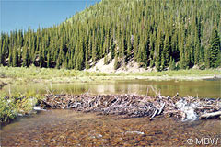
Pattern-formation – a missing link in biodiversity studies
Consider first the model for two life forms, ${ B}_{1}$ - woody and $B_{2}$ - herbaceous (or ${ b}_{1}, b_{2}$ in dimensionless forms)
(Gilad, Shachak, Meron, TPB 2007).
Distinguish between them by choosing:
$K_{1}≫K_{2}$ (order of magnitude difference in maximum standing biomass)
$Λ_{2}>Λ_{1}, M_{2}>M_{1}$ (woody growth and mortality rates significantly lower)
$E_{1}>E_{2}, ψ_{1}≫ψ_{2}$ (only woody life form is pattern forming)
Under these conditions the woody life form is hardly affected by the herbaceous one  consider first the woody life form alone.
Ben Gurion University, Ehud Meron - www.bgu.ac.il/~ehud
The interplay between the infiltration and root augmentation feedbacks can result in ecosystem engineering:
Ecosystem engineers are key species
capable of modifying their abiotic
environment significantly enough to
create habitats for other species.
(Jones, Lawton & Shachak. 1994).
Beavers that build dams.

Slide 20
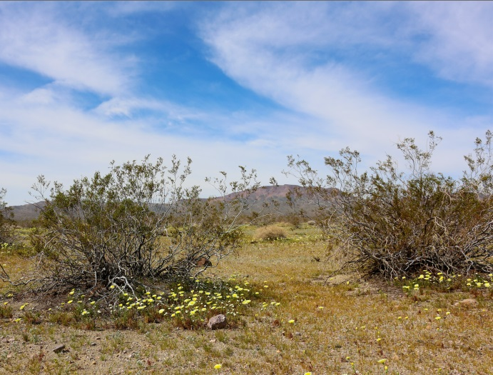
Pattern-formation – a missing link in biodiversity studies
What makes a woody life form function as ecosystem engineer?
Infiltration ($C$)
Root-to-shoot ($E$)
The two feedbacks:
Have opposite effects
on soil-water content
Ben Gurion University, Ehud Meron - www.bgu.ac.il/~ehud
Acts to increase w
Acts to decrease w
Depending on the relative strength of these two feedbacks pattern forming plants can increase or decrease the soil-water content and thereby can function or cease to function as ecosystem engineers.
By increasing the soil-water content shrubs can facilitate the growth of herbs.

Slide 21
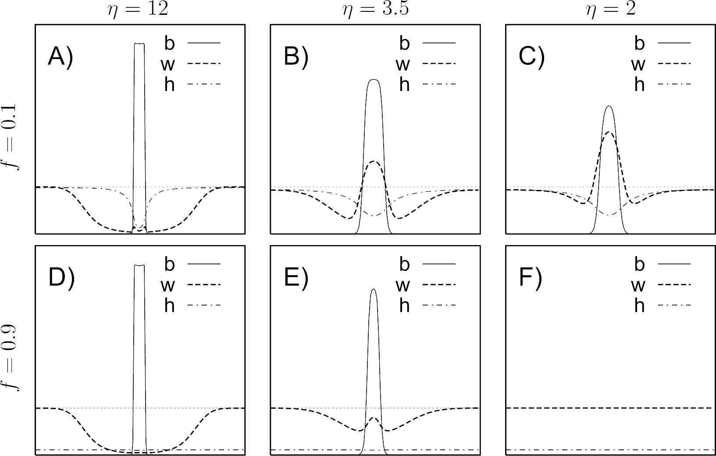
Pattern-formation – a missing link in biodiversity studies
The infiltration and root-shoot feedbacks are controlled by the parameters E $(η)$ and C. Consider an isolated biomass patch – what is the associated soil-water distribution?
(Gilad, von Hardenberg, Provenzale, Shachak, Meron, JTB 2007)
Engineering
Strong infiltration Weak root-shoot
Root-to-shoot ratio
C=10
Ben Gurion University, Ehud Meron - www.bgu.ac.il/~ehud
Infiltration contrast
Aridity stress
C=1.1
Negative engineering
Strong root-shoot Weak infiltration
14m
3.5m
3.5m

Slide 22
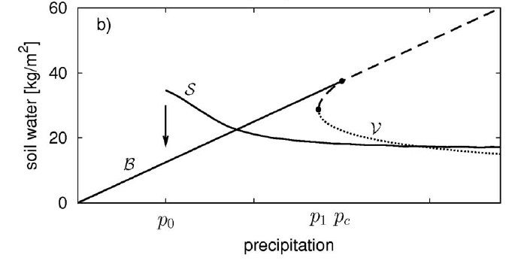
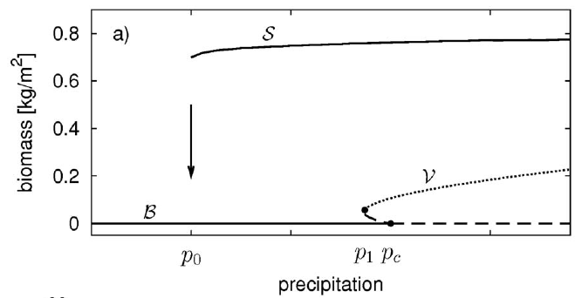
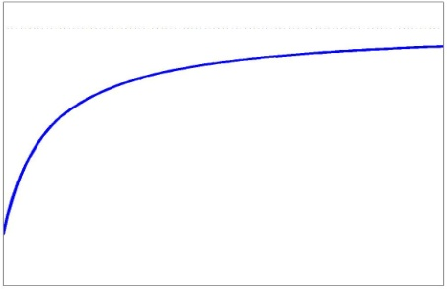
Pattern-formation – a missing link in biodiversity studies
Ecosystem engineering
along a rainfall gradient:
Max. water content
in a spot
Woody species forms a mesic patch as aridity increases. Several explanations, e.g. reduced evaporation.
Water content
in bare soil
p_{f}
Pattern-formation explanation:
Soil-water balance is determined by infiltration of surface water (gain) and uptake by roots (loss).
As precipitation decreases:
Ben Gurion University, Ehud Meron - www.bgu.ac.il/~ehud
Infiltration remains high because of
weak I(b) dependence
I
Uptake drops down because of smaller woody patch.
0
b
Notes:
So now we keep c and eta constant and vary precipitation

Slide 23
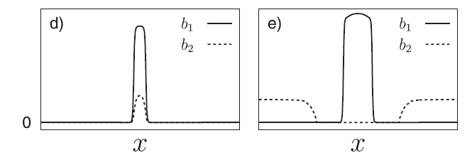
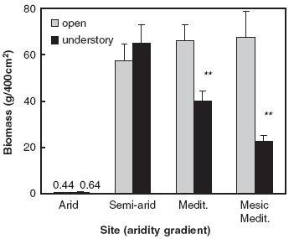
Pattern-formation – a missing link in biodiversity studies
Transition from competition to facilitation along a rainfall gradient:
Model simulation of a woody-herbaceous system:
$b_{1}$ - woody
$b_{2}$ - herbaceous
Facilitation at low p
Competition at high p
Ben Gurion University, Ehud Meron - www.bgu.ac.il/~ehud
Facilitation
Competition
Have been observed in field studies:
Annual plant biomass in the woody patch (black) and in open area (gray)
along an aridity gradient
(Holzapfel, Tielbörger, Parag, Kigel, Sternberg, 2006).
Other studies: Pugnaire & Luque, Oikos 2001; Bruno et al. TREE 2003; Malkinson & Tielbörger, Oikos 2010)
Annuals biomass
precipitation

Slide 24
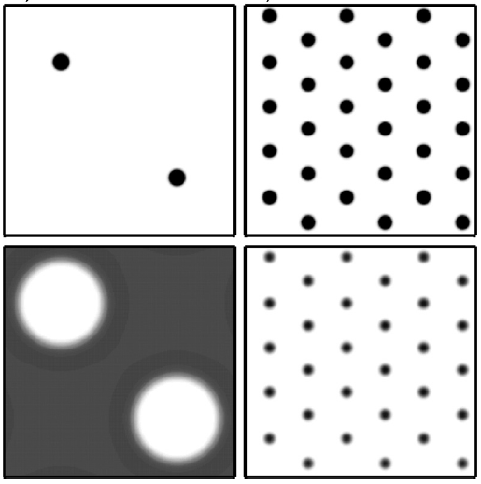
Pattern-formation – a missing link in biodiversity studies
In a given environment, transition from competition to facilitation can occur as a result of pattern transitions:
Consider bistability of woody spot pattern and uniform grassland

multiplicity of stable patterns consisting of localized woody spots in grassland (hybrid states) = savanna patterns
Savanna
Spot pattern
Ben Gurion University, Ehud Meron - www.bgu.ac.il/~ehud
Woody life form - $b_{1}$
herbaceous life form -${ b}_{2}$
Competition
Facilitation

Slide 25
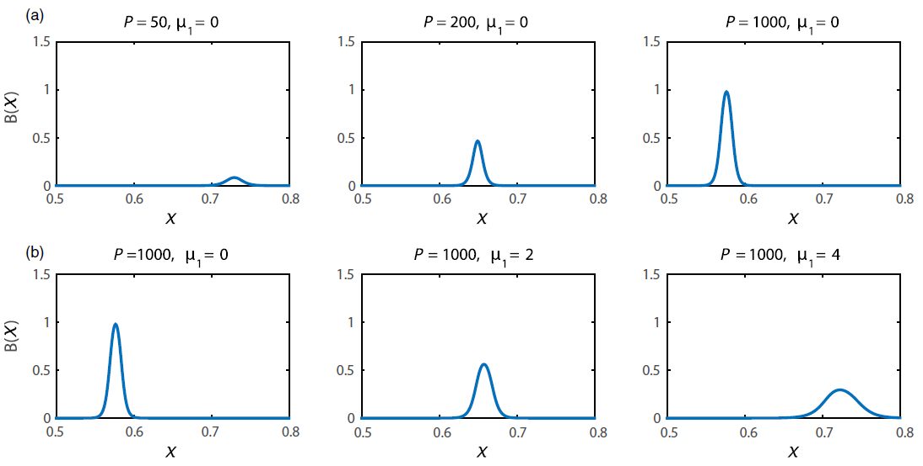
Pattern-formation – a missing link in biodiversity studies
What can we say about community level properties, such as diversity-precipitation or diversity-grazing relations?
Recall the biomass pulse solutions in trait space - study these solutions varying environmental parameters, such as precipitation rate and grazing intensity:
Ben Gurion University, Ehud Meron - www.bgu.ac.il/~ehud
Precipitation
Grazing
Notes:
So what are the mechanisms that produce such patterns? These mechanisms are associated with two important feedbacks …

Slide 26
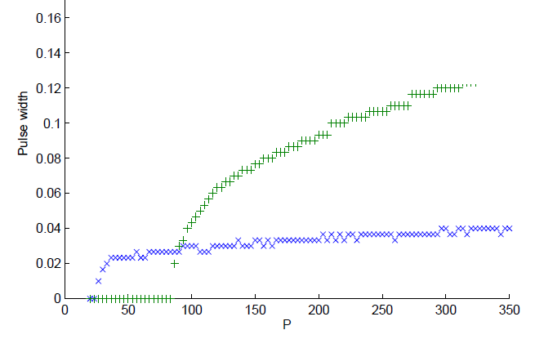
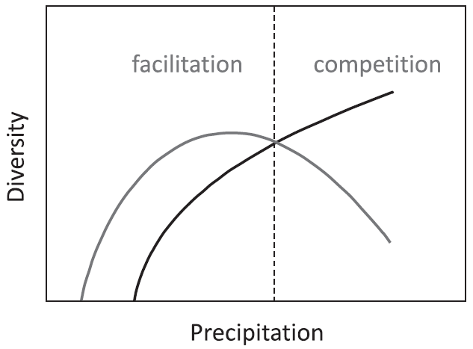
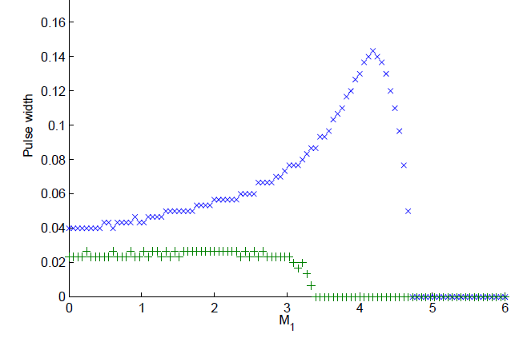
Pattern-formation – a missing link in biodiversity studies
For spatially uniform herbaceous communities we obtain:
Monotonically increasing
With grazing
(Nathan, Osem, Shachak, Meron, to appear in J. Ecology)
Diversity
Diversity-precipitation relations
Without grazing
Diversity-grazing relations
Ben Gurion University, Ehud Meron - www.bgu.ac.il/~ehud
Precipitation
High precipitation
Supports known hypotheses:
1. Intermediate Disturbance
hypothesis (Grime 1973 and others)
Diversity
2. Grazing Reversal Hypothesis positive (negative) effect in productive (unproductive) habitats (Milchunas et al. 1988 and others)
Low precipitation
Grazing
Notes:
So what are the mechanisms that produce such patterns? These mechanisms are associated with two important feedbacks …

Slide 27
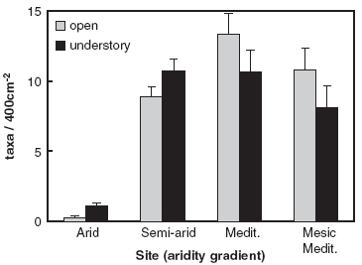
Pattern-formation – a missing link in biodiversity studies
Studies of annual diversity in the presence of woody patches (shrubs) show hump shape diversity-precipitation relations :
(Holzapfel, Tielbörger, Parag, Kigel, Sternberg, 2006).
Recall woody-herbaceous interactions:
low $p$
high $p$
Ben Gurion University, Ehud Meron - www.bgu.ac.il/~ehud
Exclusion of herbs by dense woody patterns at high precipitation and facilitation at low precipitation can explain the observed hump-shape relation
Can be studied by adding a biomass equation for a pattern-forming woody life form
Notes:
So what are the mechanisms that produce such patterns? These mechanisms are associated with two important feedbacks …

Slide 28
Pattern formation – a missing link in studies of regime shifts
Biodiversity
Species richness, composition,
interactions, spatial
organization
Ecosystem function
Productivity, resource-use efficiency, resilience
Pattern formation
Changes in inter-specific interactions induced by patterning
Ben Gurion University, Ehud Meron - www.bgu.ac.il/~ehud
Vegetation patchiness induced by water stress
Regime shifts : patterned state ⇔ uniform state
Abiotic environment
Rainfall, light , soil-water, nutrients, disturbances, exogenous heterogeneity
Notes:
Back to the context of ecosystems, ecologists are interested in understanding the relationships …

Slide 29
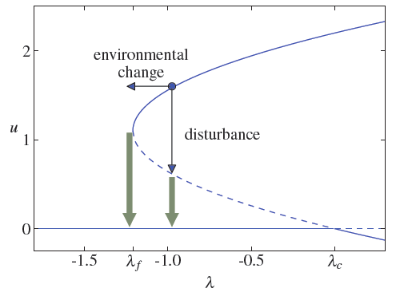
Pattern formation – a missing link in studies of regime shifts
The common view
productive state
Regime shift - abrupt transition from
a stable state to an alternative stable
state, induced by environmental
change or disturbance
(Scheffer et al., Nature 2001)
Lyapunov function
Fold bifurcation
Example: desertification
A regime shift from a productive
state to a less productive state.
unproductive state
Ben Gurion University, Ehud Meron - www.bgu.ac.il/~ehud
p_{f}
p
p_{c}
Early indicators for impending shifts
(Dakos et al 2008; Chisholm and Filotas 2009;
Guttal and Jayaprakash 2008, 2009; Dakos et al 2010; and others)
Among the proposed indicators:
Increase of temporal autocorrelation and variance
Skewness of time-series distributions

Slide 30
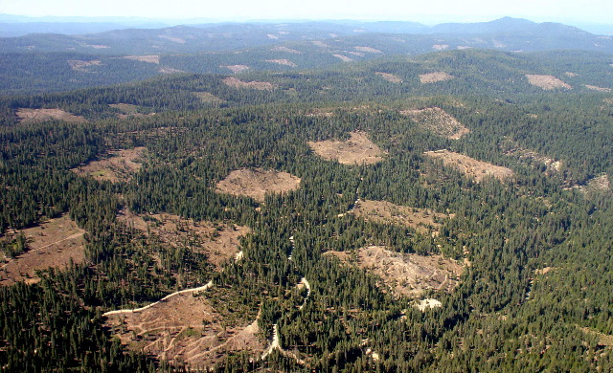
Pattern formation – a missing link in studies of regime shifts
The common view does not capture
two spatial aspects:
productive state
Disturbances are likely to be local:
rather than shifting the whole system
to the alternative stable state, the
disturbances can create local domains
of the alternative state.
unproductive state
p_{f}
p
p_{c}
Ben Gurion University, Ehud Meron - www.bgu.ac.il/~ehud
productive
unproductive
space
Clear cutting in Blue Creek Watershed near
Montana-Idaho border
Photo courtesy of Bruse Castle - EPFW

Slide 31
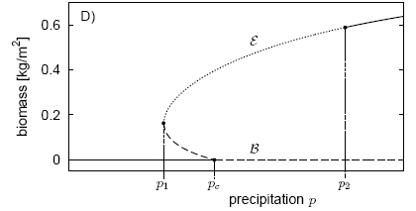
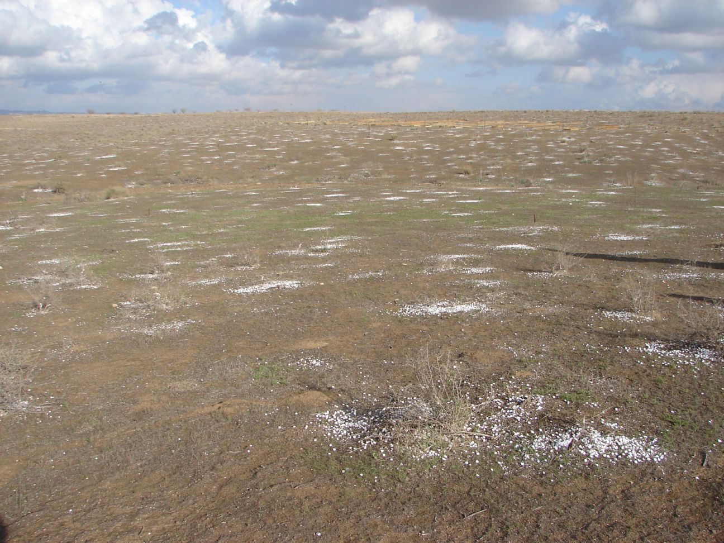
Pattern formation – a missing link in studies of regime shifts
Regime shifts in drylands generally involve patterned states:
Uniform vegetation  gap pattern
Spot pattern  bare soil
Take these two aspects into account in a concrete context – the Namibian fairy-circle (NFC) ecosystem:
Ben Gurion University, Ehud Meron - www.bgu.ac.il/~ehud
Desertification in northern Negev – spot pattern  bare soil (Moshe Shachak)
Fairy circles - bare patches of sandy soil
$$∂_{t}b=G_{b}b\left(1−b/κ\right)−b+∇^{2}b$$
$$∂_{t}w={p−Lw−G_{w}w}_{ }+δ_{w}∇^{2}w$$
$$G_{b}≈νw{\left(1+ηb\right)}^{2}$$
$$G_{w}≈νb{\left(1+ηb\right)}^{2}$$

Slide 32
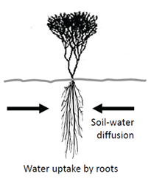
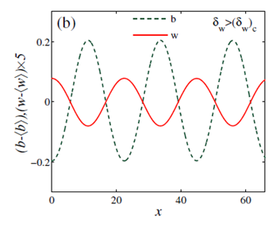
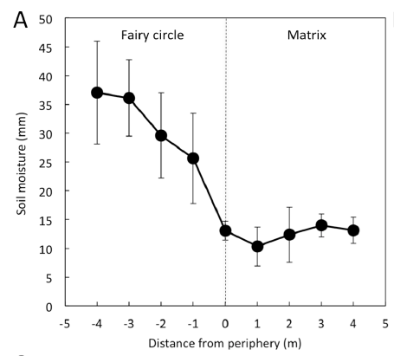
Pattern formation – a missing link in studies of regime shifts
The sandy soil and the confined root zones typical of the grass species in the NFC ecosystem allows model simplification to
$$∂_{t}B=G_{B}B\left(1−B/K\right)−MB+{D_{B}∇}^{2}B$$
$G_{B}=ΛW{\left(1+EB\right)}^{2}$
$$∂_{t}W={P−LW−G_{W}W}_{ }+D_{W}∇^{2}W$$
$$G_{W}=ΓB{\left(1+EB\right)}^{2}$$
The simplified model still captures a single pattern-forming feedback associated with strong local uptake and soil-water transport.
Ben Gurion University, Ehud Meron - www.bgu.ac.il/~ehud
Implies anti-phase biomass and soil-water distributions
(Kinast, Zelnik, Bel, Meron, PRL 2014)
which are consistent with field observations
(Cramer and Barger PLOS ONE 2013)

Slide 33
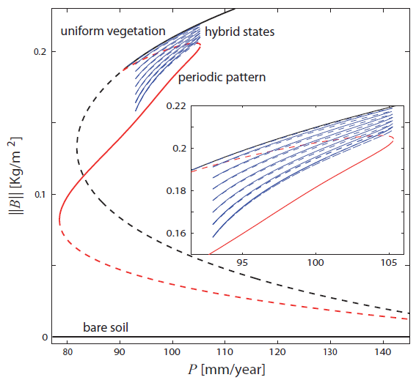
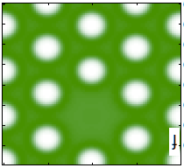
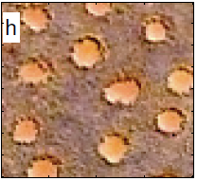
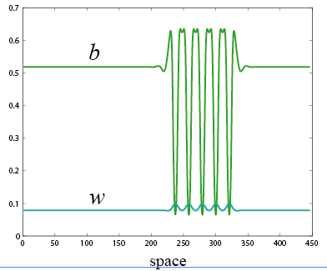
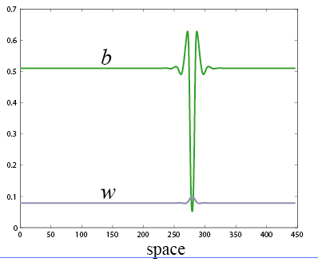
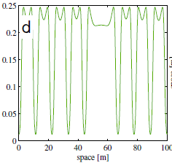
Pattern formation – a missing link in studies of regime shifts
Choosing parameters that fit the NFC ecosystem we find the bifurcation diagram (Zelnik, Meron, Bel, PNAS 2015):
Within the bistability range of uniform vegetation and periodic pattern – many more solution branches of hybrid states:
Ben Gurion University, Ehud Meron - www.bgu.ac.il/~ehud
space
space
Homoclinic snaking
(Edgar Knobloch, Nonlinearity 2009)
Under strong rainfall fluctuations state transitions between uniform and patterned vegetation may not be abrupt but rather gradual or incipient, involving full or partial cascades of hybrid state transitions

Slide 34
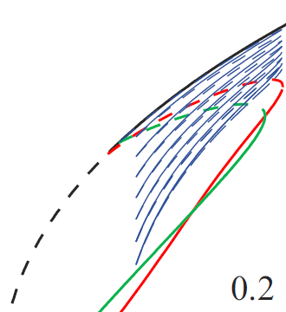
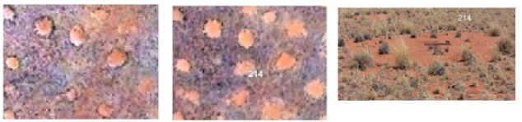
Pattern formation – a missing link in studies of regime shifts
Model simulations of periodic escapes from the snaking range:
Uniform vegetation
(Zelnik, Meron, Bel, PNAS 2015)
Any indications of such processes in the NFC ecosystem?
Hybrid states
Periodic patterns
Ben Gurion University, Ehud Meron - www.bgu.ac.il/~ehud
FC
birth
FC
death
(Tschinkel, PLoS ONE 2012)
FC birth and death are instances of hybrid-state transitions

Slide 35
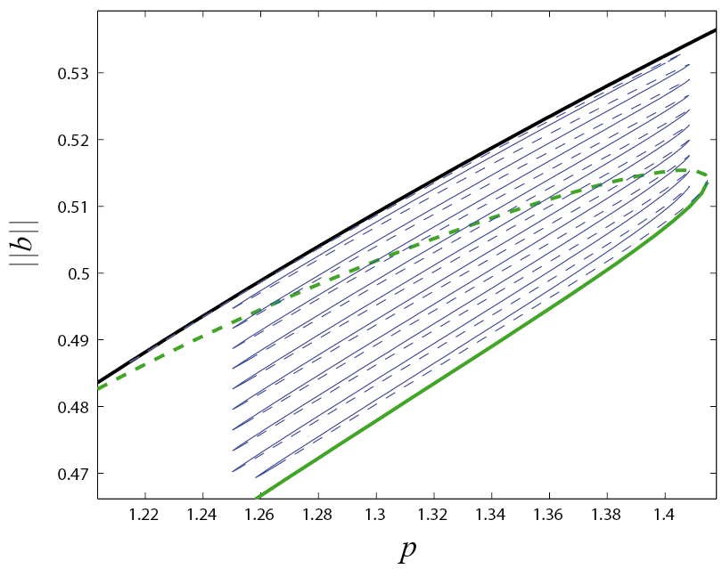
Pattern formation – a missing link in studies of regime shifts
Drought in 2007: 41mm/y vs. 100-200mm/y in other years
2004 2008 2010 2013
Observations
(Namibia)
Birth of FC = front propagation outside snaking range ?
Model simulations
Ben Gurion University, Ehud Meron - www.bgu.ac.il/~ehud
IC – 2004 + long simulation at 102mm/y (within snaking range)
Drought – 1y simulation at 84mm/y (outside snaking range)
Drought is over - 4y simulation at 102mm/y (within snaking range)
Drought is over – 5y simulation at 102mm/y
Escape from and return to snaking range explain observations . Repeated droughts  cascade of such events towards the periodic gap pattern.
Vegetation patterning can mitigate the adverse effects of state transitions (regime shifts), and constrain loss of ecosystem function.

Slide 36
Pattern-formation – a missing link in restoration studies
Biodiversity
Species richness, composition,
interactions, spatial
organization
Ecosystem function
Productivity, resource-use efficiency, resilience
Pattern formation
Changes in inter-specific interactions induced by patterning
Restoration of degraded areas by water harvesting
Ben Gurion University, Ehud Meron - www.bgu.ac.il/~ehud
Vegetation patchiness induced by water stress
Regime shifts : patterned state ⇔ uniform state
Abiotic environment
Rainfall, light , soil-water, nutrients, disturbances, exogenous heterogeneity
Discuss restoration in the context of human intervention and ecological integrity, defined as the degree to which an ecosystem is self organized.
Notes:
Back to the context of ecosystems, ecologists are interested in understanding the relationships …

Slide 37
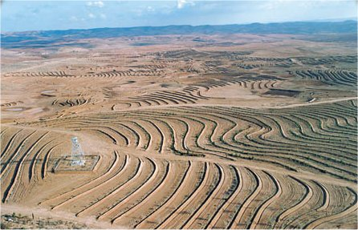
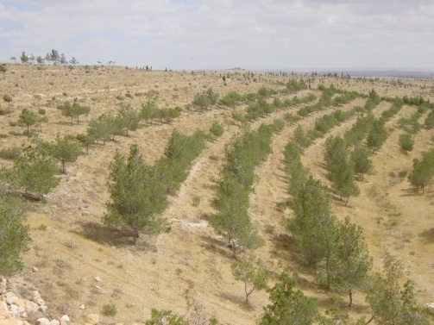
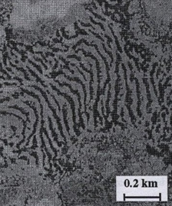
Human intervention and ecological integrity
Ecosystems are often disturbed by human interventions:
Grazing - to feed sheep, goats, …
Landscape modulations - to restore degraded landscapes by water harvesting.
In agriculture – plowing, irrigating, pruning, multiple cropping.
Intervention practices often results in reduced ecological integrity, because they do not follow the natural modes of ecosystem dynamics.
Use the model and pattern formation theory to identify these modes and let them guide the intervention.
Ben Gurion University, Ehud Meron - www.bgu.ac.il/~ehud
Restoration of degraded landscapes:
Periodic stripe-like embankments that capture runoff and along which the vegetation is planted. Characterized by their wavenumber $k_{f}$ or wavelength $2π/k_{f}.$
Since the unmodulated system tends anyway to form patterns (wavenumber $k_{0}$), this is a spatial resonance problem analogous to periodically forced oscillators.

Slide 38
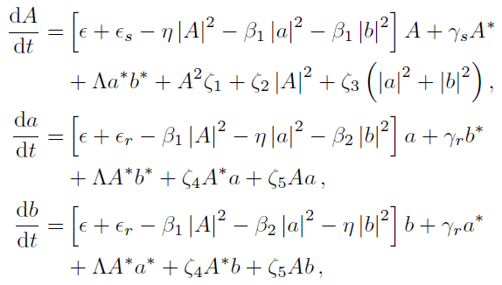
High ecological-integrity restoration
The common practice - vegetation band at each embankment, leads to a 1:1 resonant stripe pattern
embankment
vegetation
2d spatial systems, however, can respond by forming 2d, 2:1 resonant rhombic patterns:
The response involves the growth of two oblique modes, $\exp\left(ik_{±}⋅x\right){ k}_{±}=k_{x}\hat{x}±k_{y}\hat{y}$
where $k_{x}=\frac{k_{f}}{2} ,$and $k_{y}$ is s.t. $k_{x}^{2}+k_{y}^{2}=k_{0}^{2} ,$
Ben Gurion University, Ehud Meron - www.bgu.ac.il/~ehud
in addition to the stripe mode $\exp\left(ik_{f}x\right)$.
In terms of these modes the biomass can be approximated by
$k_{f}$ - modulation wavenumber
$k_{0}$ - wavenumber of unmodulated system
$$Biomass≈Ae^{−ik_{f}x}+a{[e}^{ik_{+}⋅x}+e^{ik_{−}⋅x}]+c.c.$$
Derive equations for the modes’ amplitudes, use them to study the interaction between stripes $(A,0)$ and rhombic patterns $\left(A,a\right)$
$$ρ_{S}=\left|A\right|, ρ_{R}=|a|$$
$\left\|b\right\|={\left(ρ_{s}^{2}+2ρ_{R}^{2}\right)}^{1/2}$
(Mau, Hageberg, Meron, PRL 2012; Mau, Haim, Meron, PRE 2015)

Slide 39
High ecological-integrity restoration
Amplitude equation analysis 
the rhombic pattern is more robust: extends to lower $p$ values and destabilizes the stripe pattern
1:1 stripe pattern (S)
Moreover, the stripe pattern has poor resilience to droughts
$$\left\|b\right\|$$
2:1 rhombic pattern (R)
Bare soil (B)
Ben Gurion University, Ehud Meron - www.bgu.ac.il/~ehud
p
Restoration in 1:1 stripes can result in collapse to bare soil  low ecological integrity because the restoration does not promote the growth of the oblique modes.
Restore instead by partial plantation to create the oblique modes and to quickly converge to the rhombic patterns, keeping ecological integrity at a high level from the start
(Mau, Lev, Meron, PRE 2015)

Slide 40
Summary of Lecture II
Vegetation pattern formation is a landscape-level mechanism to cope with water stress.
It often results from positive feedbacks between local vegetation growth and water transport to the growth location.
+
Local vegetation growth
Water transport towards growing vegetation
+
To study vegetation pattern formation, the manners by which it is affected by the abiotic environment and its coupling to community structure we need a means for scaling up small scale feedbacks to large scale patterns and organism-level traits to community structure. We do that by mathematical modeling.
Ben Gurion University, Ehud Meron - www.bgu.ac.il/~ehud
A platform of mathematical models has been introduced. It captures three different pattern forming feedbacks and allows the derivation of community-level properties. In applying it to specific ecological contexts various simplifications can be made.

Slide 41
Summary of Lecture II
Using this platform we discussed manners by which pattern formation can affect the relations between the abiotic environment, biodiversity and ecosystem function. We discussed how vegetation patterns
change along a rainfall gradient – domain-size change, wavelength change, morphology change,
affect interspecific interactions in woody-herbaceous systems (transitions from competition to facilitation), and the diversity-precipitation relationship,
affect the nature of regime shifts, making them gradual or incipient,
Ben Gurion University, Ehud Meron - www.bgu.ac.il/~ehud
Finally, we discussed how to interfere with ecosystem dynamics keeping its ecological integrity high. We used vegetation restoration as an illustrative example, where fragmented plantation along embankments puts the system along its natural modes of self organization.

Slide 42
Collaborators
Students:
Erez Gilad (former PhD student, now at BGU)
Assaf Kletter (former PhD student)
Jonathan Nathan (former PhD student)
Yair Mau (former PhD student, now postdoc at Duke U)
Lev Haim (former PhD student)
Shai Kinast (former PhD student, now at NRCN)
Yuval Zelnik (PhD student)
Paris Kyriazopoulos (former PhD Student, UCM, Spain)
Efrat Sheffer (former M.Sc student, now at Hebrew U)
Omer Tzuk (PhD student)
Colleagues:
Jost von Hardenberg (ISAC Turine)
Antonello Provenzale (ISAC Turine)
Hezi Yizhaq (BGU)
Moshe Shachak (BGU)
Yagil Osem (Agricultural Research Organization)
Golan Bel (BGU)
Aric Hagberg (LANL)
Ben Gurion University, Ehud Meron - www.bgu.ac.il/~ehud

Slide 43
New book
About the book
Nonlinear Physics of Ecosystems introduces the concepts and tools of pattern formation theory and demonstrates their utility in ecological research using problems from spatial ecology.
The first part of the book gives an overview of pattern formation and spatial ecology, showing how these disparate research fields are strongly related to one another. The next part presents an advanced account of pattern formation theory. The final part describes applications of pattern formation theory to ecological problems, including self-organized vegetation patchiness, desertification, and biodiversity in changing environments.
Focusing on the emerging interface between spatial ecology and pattern formation, this book shows how pattern formation methods address a variety of ecological problems using water-limited ecosystems as a case study.
Reviews:
Editor invited: in CRC’s book webpage
In Journals:
Hugo Fort, Physics Today, 68(10), 46 (2015)​
​​​​​​​​K. Alan Shore, Contemporary Physics​ (2015)
D. DeAngelis, upcoming in SIAM.
Ben Gurion University, Ehud Meron - www.bgu.ac.il/~ehud

